Slide 1
Software Development 3
Polymorphism

Slide 2
Polymorphism
The term polymorphism literally means “having many forms”
A polymorphic reference is a variable that can refer to different types of objects at different points in time
All object references in Java are potentially polymorphic and can refer to an object of any type compatible with its defined type

Slide 3
Polymorphism
Polymorphism ensures that the appropriate method is called for an object of a specific type when the object is disguised as a more general type
Polymorphism is already supported in Java — all you have to do is use it properly
A collection (array, list, etc.) contains objects of different but related types, all derived from the same common base class

Slide 4
Polymorphism
Suppose we create the following object reference variable
BankAccount b
Java allows this reference to point to a BankAccount object or to any object of any compatible type
If class CurrentAccount extends BankAccount, a CurrentAccount object is a compatible type with a BankAccount object and a reference to one can be stored in the reference variable b:
b = new CurrentAccount();

Slide 5
References & Inheritance
An object reference can refer to an object of its class or to an object of any class related to it by inheritance
For example, if the CurrentAccount class extends the BankAccount class, then a BankAccount reference could be used to point to a CurrentAccount object
BankAccount
BankAccount b;
b = new CurrentAccount();
CurrentAccount

Slide 6
References & Inheritance
Assigning a child object to a parent reference is considered to be a widening conversion, and can be performed by simple assignment
The widening conversion is the most useful
Assigning a parent object to a child reference can be done, but it is considered a narrowing conversion and two rules/guidelines apply:
A narrowing conversion must be done with a cast
A narrowing conversion should only be used to restore an object back to its original class (back to what it was “created as” with the new operator)

Slide 7
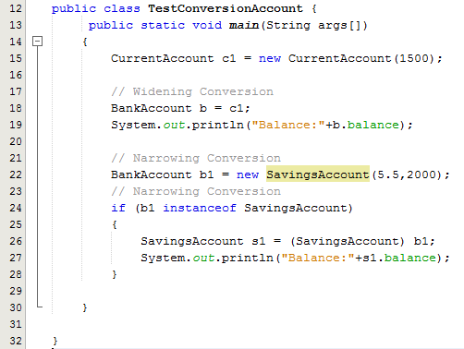
References & Inheritance

Slide 8
Polymorphism via Inheritance
It is the type of the object being referenced that determines which method is invoked
If the BankAccount class has a deposit() method, and the CurrentAcccount class overrides it, consider the following invocation: b.deposit();
If b refers to a BankAccount object, it invokes the BankAccount version of deposit()
If b refers to a CurrentAccount object, it invokes the CurrentAccount version of deposit()
See Sample Programs on Moodle

Slide 9
Polymorphism and Dynamic Binding
If the object of the subclass has overridden a method in the superclass:
If the variable makes a call to that method the subclass’s version of the method will be run.
BankAccount b1 = new CurrentAccount(1500);
b1.deposit(400);
System.out.println(b1);
Java performs dynamic binding or late binding when a variable contains a polymorphic reference.
The Java Virtual Machine determines at runtime which method to call, depending on the type of object that the variable references.

Slide 10
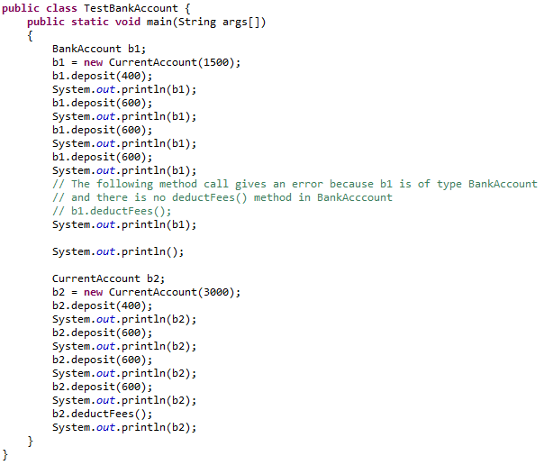
Polymorphism via Inheritance (Example)

Slide 11
Arrays of Object References
Arrays can be used to store variables
int
int intArray [] = new int[4];
double
double doubleAray[] = new double[50];
String
String rainbow []= {“red”, “orange”, “yellow”, “green”, “blue”, “indigo”, “violet”};
Arrays can also be used to store object references
Objects that are instances of classes that you have created

Slide 12
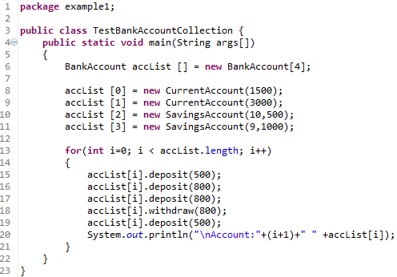
Example – Array of BankAccount Object References

Slide 13
Using Object Arrays
One instance of the class is stored in each element of the array
For every instance the constructor must be called
Just as with variable arrays, the instances of the object array are referenced by their position in the array:
accList [0] = new CurrentAccount(1500);
However accessing the data of each object is a little different
System.out.println("\nAccount:"+(i+1)+" " +accList[i]);

Slide 14
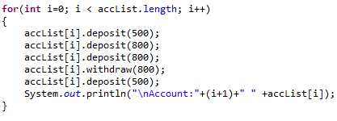
Polymorphic Collections
Allows us to have an array (collection) of different types of object references and to create an array of reference variables whose type is a base class (e.g. BankAccount)
The Array can reference objects of subclasses (e.g. CurrentAccount, SavingsAccount)
4
Note the polymorphic calls are made to the deposit() and withdraw() methods

Slide 15

Casting
Say we want to call the methods deductFees() and calcInterest()
We cannot call these methods using the BankAccount reference. Why not?
Because these methods are particular to each subclass
deductFees() is only defined in CurrentAccount
calcInterest() is only defined in SavingsAccount
Error below when we try to use this line of code

Slide 16
Casting
Casting means converting the type of an item to a new type
It only makes sense to cast object references up and down the paths of the inheritance hierarchy
You cannot cast references between unrelated objects.
Going back to the BankAccount example
we may want to determine exactly the type of object that BankAccount references and call some method specific to that class i.e. deductFees() or calcInterest()
If a method exists in one subclass and not another, we cannot call it without casting

Slide 17

Casts - Example
Operator instanceof determines whether a reference variable that points to an object is of a particular class type
This expression evaluates to true if accList[i] points to an object of the class CurrentAccount; otherwise it evaluates to false
We then must explicitly cast the superclass object accList[i] to the subclass type CurrentAccount.
When we do this we can now call on the method deductFees()

